Slide 1
Configure HTTP server and demonstrate the process to access a website using the IP address in real-time and simulation mode
Practical
Software required: Cisco Packet Tracer

Slide 2
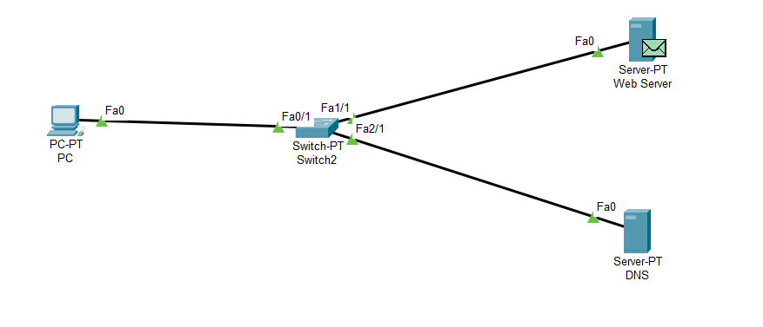
Design

Slide 3
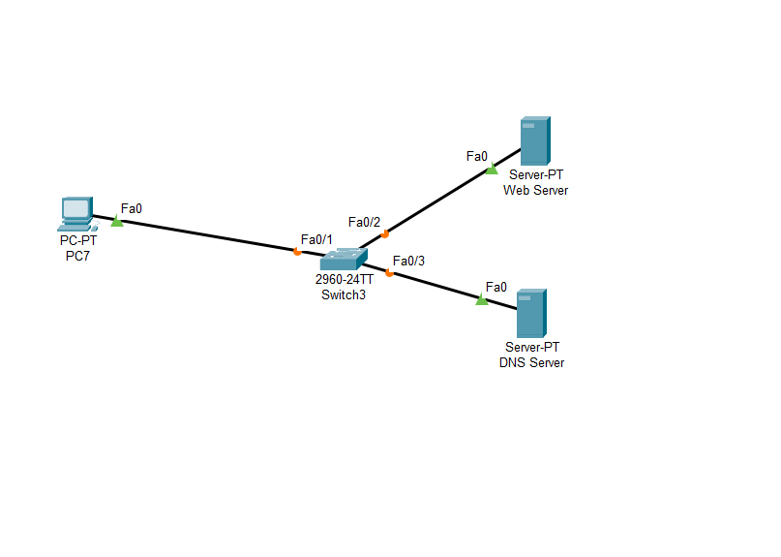
Step 1: Open Cisco Packet Tracer Step 2: Select PC and Switch Step 3: Select Two Server

Slide 4
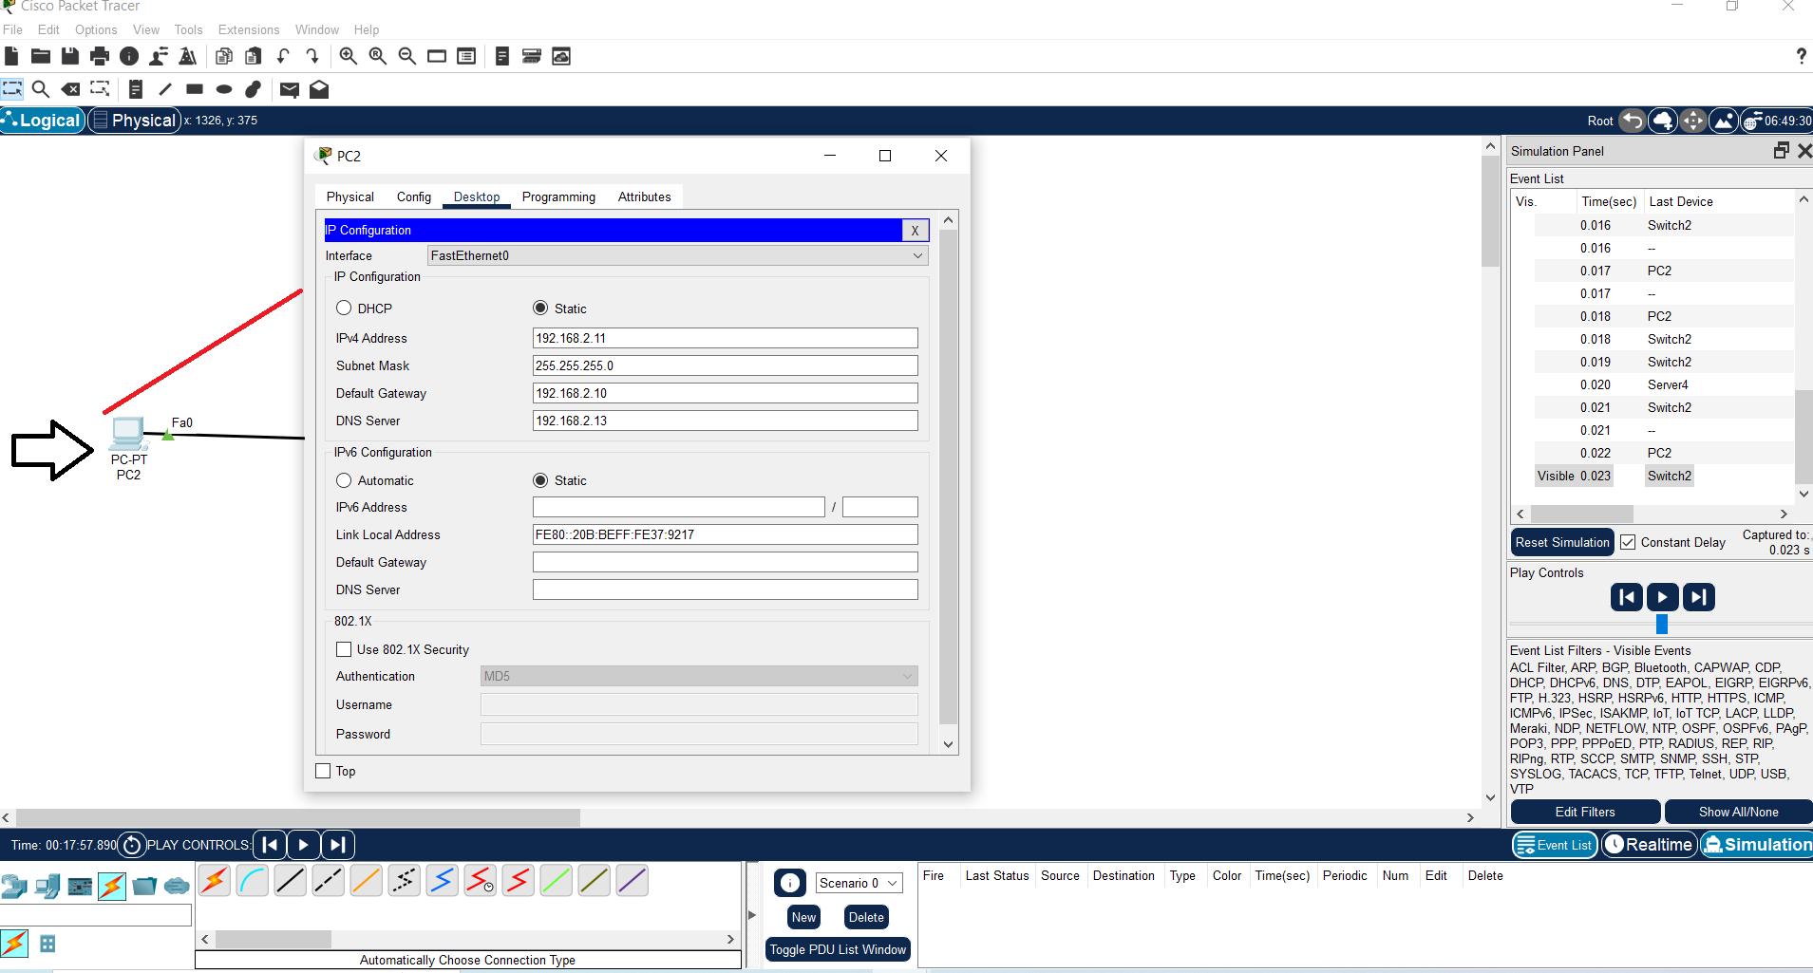
Step 4: Configure PC

Slide 5
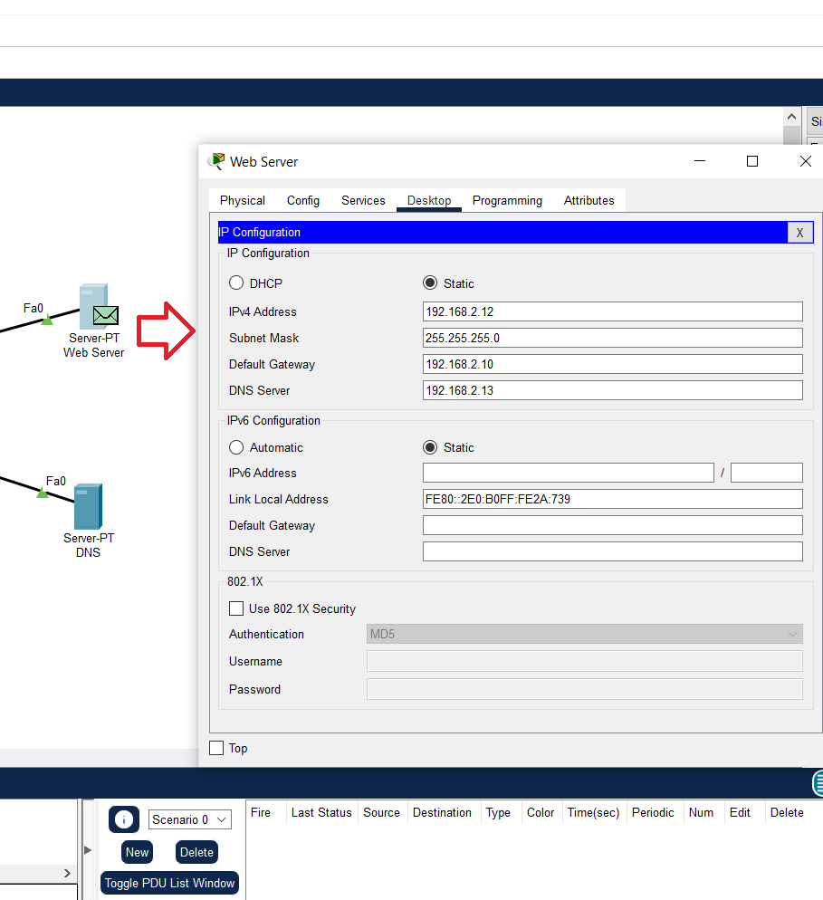
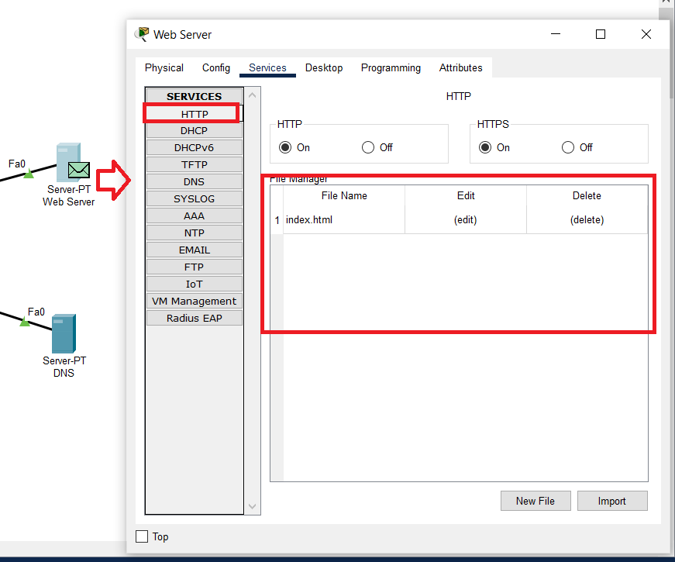
Step 5: Configure Web Server

Slide 6
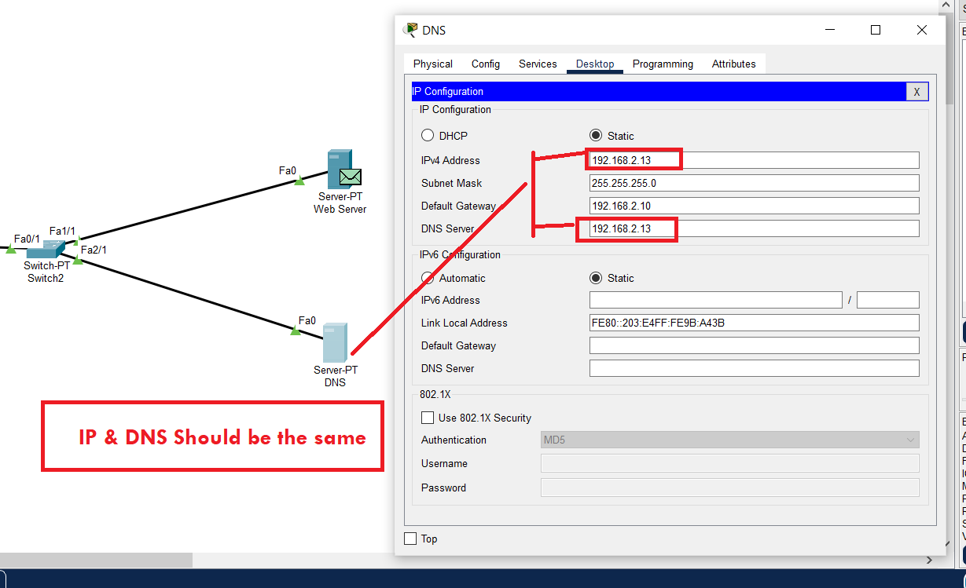
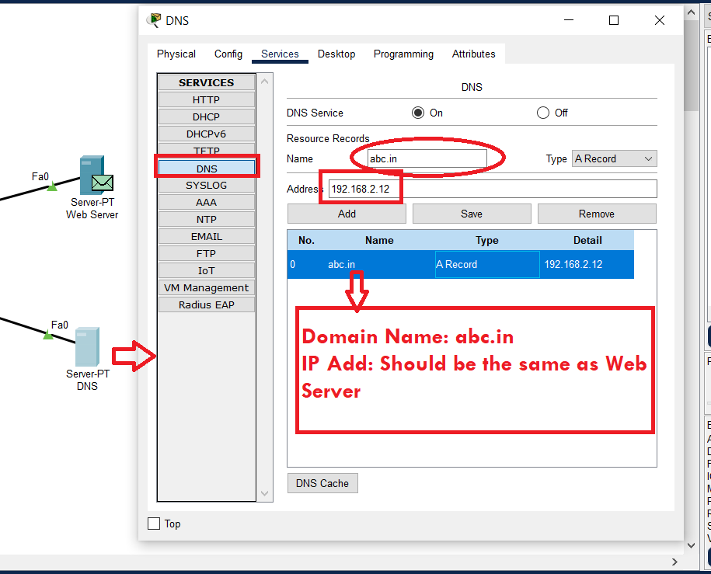
Step 6: Configure DNS

Slide 7
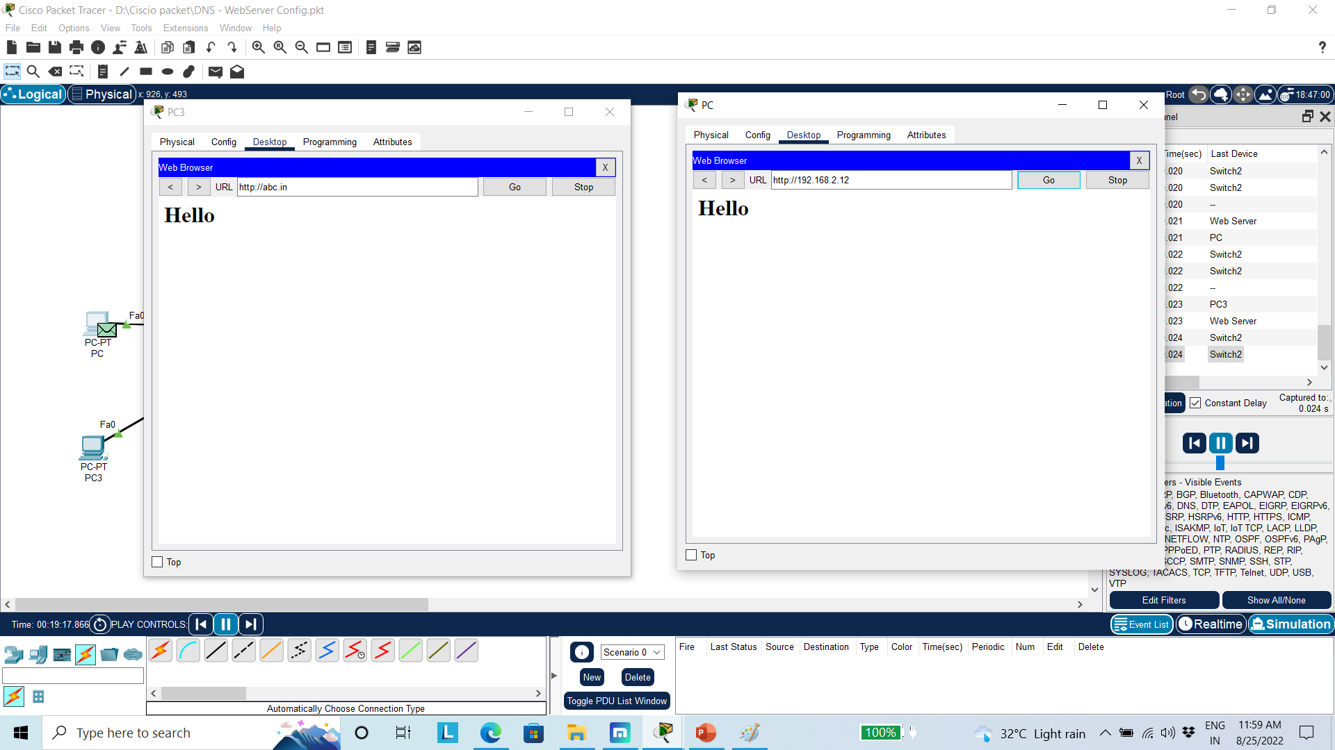
Both IP and DNS

Slide 8
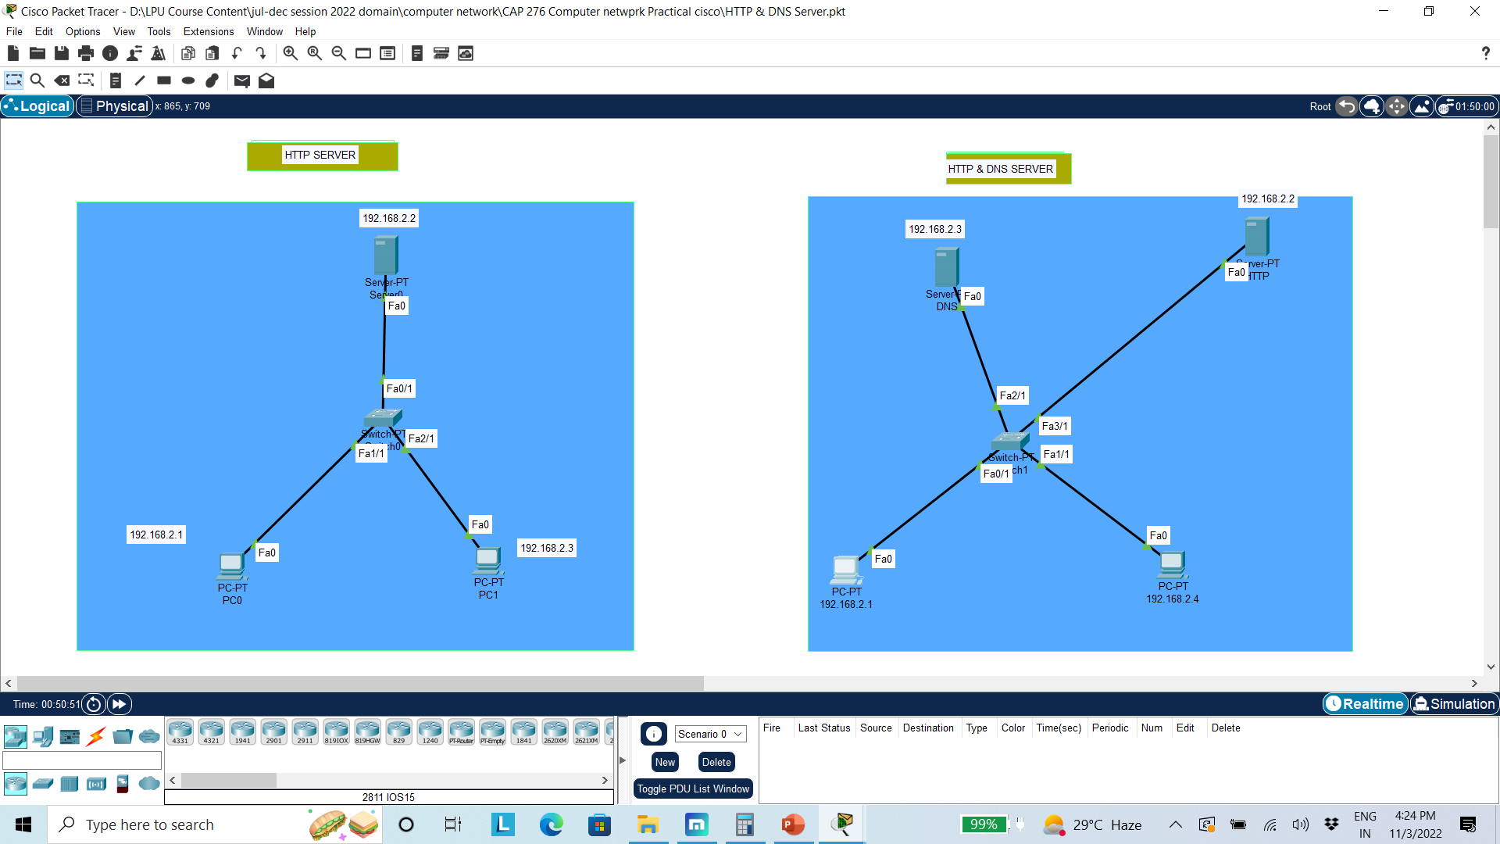

Slide 9
Class Work
Connect two PC with Switch
Configure them
Access the web page from web server using IP
Access the web page from web server through DNS
Both IP and DNS needs to access at same time
Display the message

